Slide 1
Machine Learning To Predict Patient Readmissions
vLiFE
By
Utsav Dutta
Under the guidance of
Ankit Khatri and Avinash Reddy

Slide 2
A Look At The Problem
In the United States, hospital readmissions within a span of 30 days turn out to be an immense burden on the healthcare system and the patient's lifestyle.
A USFC study in the US shows that 27% of readmissions are potentially avoidable through better diagnosis at discharge or having a predictive mechanism to evaluate the chance of a patient being readmitted based on various factors.
The cost per readmission in the US varies from 10 to 14 thousand dollars, subject to the insurance plan, medical facilities utilized etc.
The Government penalizes hospitals for early readmissions as it is considered a poor marker of quality of healthcare.

Slide 3
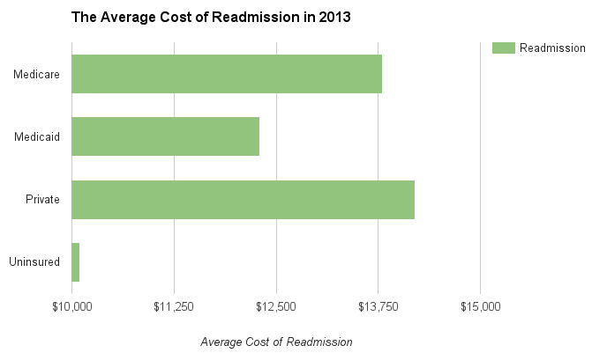
The Stakeholders
This model is aimed at 3 major factors:
Improving lives of patients
Reducing the burden on the healthcare system
Reducing money spent by insurance firms
This number blows up to $26 billion annually for Medicare insurance.
$17 billion of this is considered 'potentially avoidable'.
Courtesy: USFC study (2013)

Slide 4
Approach and Outcome
MIMIC III, a vast medical database of EMR/EHR records, contains multiple co-dependent tables of patient data.
This contains biological and demographic information of patients in the USA anonymized due to privacy reasons.
The tables are linked through multiple parameters so as to allow the viewer to determine correlations between multiple tables.
This use case aims at deriving readmission characteristics from this (or rather, these) datasets to develop a model that could assist the physician in deciding whether a patient should be discharged or not.
Our model predicts 3 outcomes:
Patient will be readmitted within one month
Patient won't be readmitted within one month

Slide 5
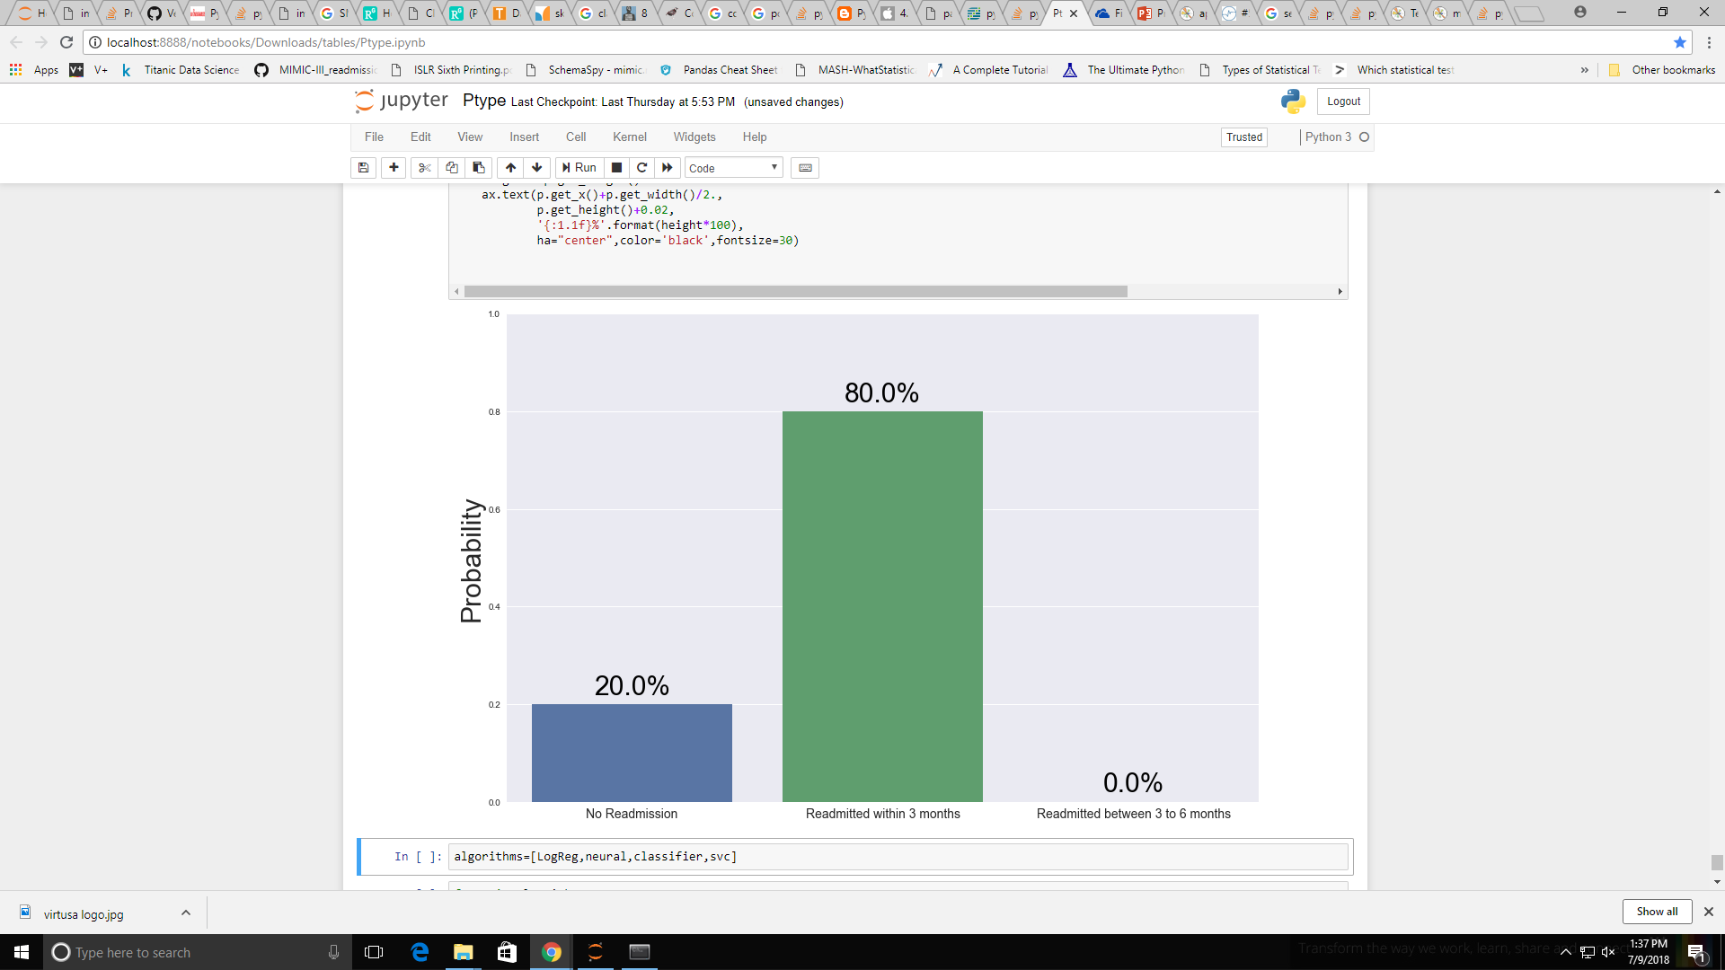
The Desired Output
The use case aims to have an interface where a physician can enter a patient's data and the model would output a probability distribution of the aforementioned 3 options.
An example for a particular test case is given below.
Note:
This is an actual extract from a test case in the code

Slide 6
Technical Requirements
The technical resources used are:
IPython Notebook
Python libraries:
Numpy
Pandas
Sci-Kit Learn
MatplotLib
Seaborn
Collections
Imblearn
Scipy Stats
API to access the data.

Slide 7
Exploring the Data
The model was based on 10,000 patient records.
The interlinking of tables on MIMIC is provided in the Schema
The tables used here are:
Table_Name | Vital_Info
Admissions | Demographic, admission details
Patients | Unique ID, gender
drgcodes | Drugs prescribed
Diagnoses | Icd9_code of the disease
Prescriptions | Prescribed medications and doses
icustays | Icu stay details
Procedures | In patient procedures

Slide 8
Data Structure and Parameters
This section aims at understanding the nature of the data, forming conclusions on the correlation of variables and cleaning up erroneous values.
The data is spread across multiple tables through unique links.
A deeper look at the tables is required to extract features that may be relevant to the model.
These can be later validated through statistical testing.
A few recoccuring parameters:
subject_id: a unique patient identification ID. Links patient related tables
hadm_id : a hospital centric ID used to identify patients. Links hospital related tables.

Slide 9
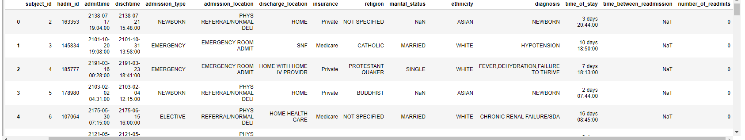
Admissions
This is a sample of the admissions table.
From the admit and discharge times we can find the time of stay.
From the reoccurences of subject ID we can find number_of_readmits.
From the time difference between time between previous discharge and new admission we can find the time_between_readmission.

Slide 10
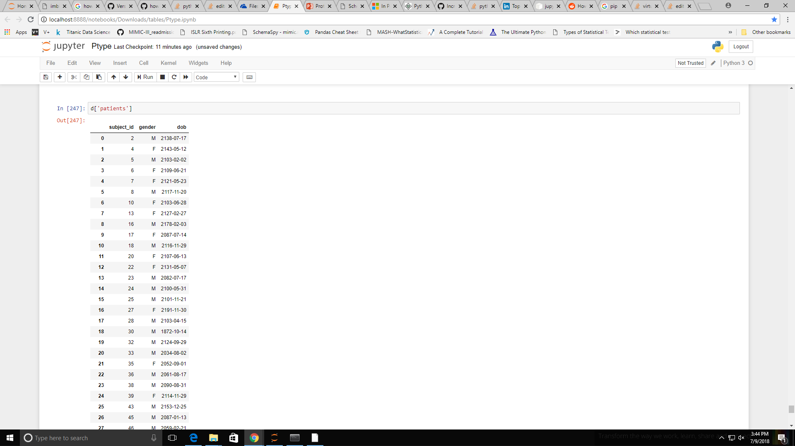
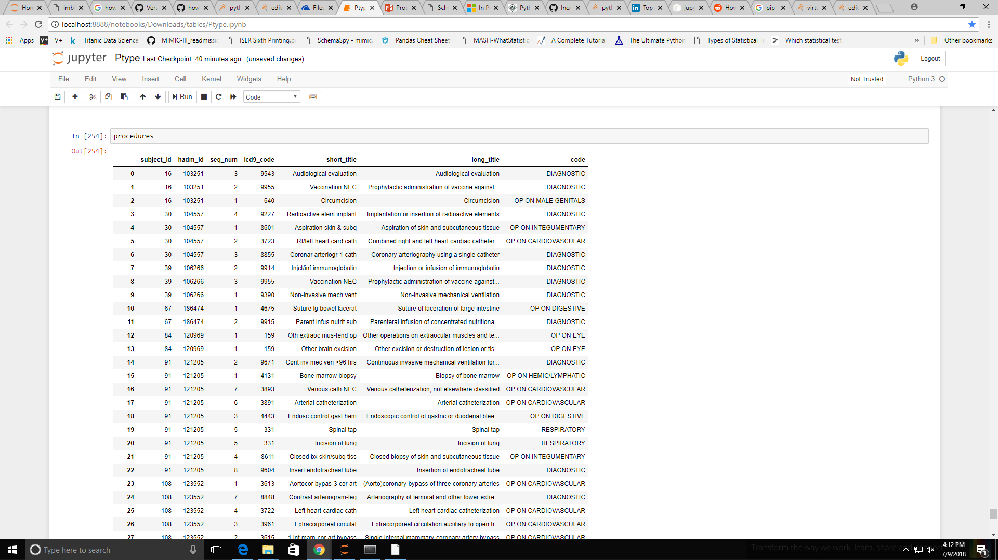
Patients
As evident, we can extract age (admittime minus dob) which will possibly be a strong indicator for readmissions.
Gender may also be a strong indicator for readmissions. We shall check this later with tests.
In admissions and patients, we remove the records of the dead patients as they contribute in no way to readmission predictions.
Procedures
This table gives us the patient specific details about the procedures undergone at the hospital. The icd9_code classifies the procedures.
The names of the procedures are given

Slide 11
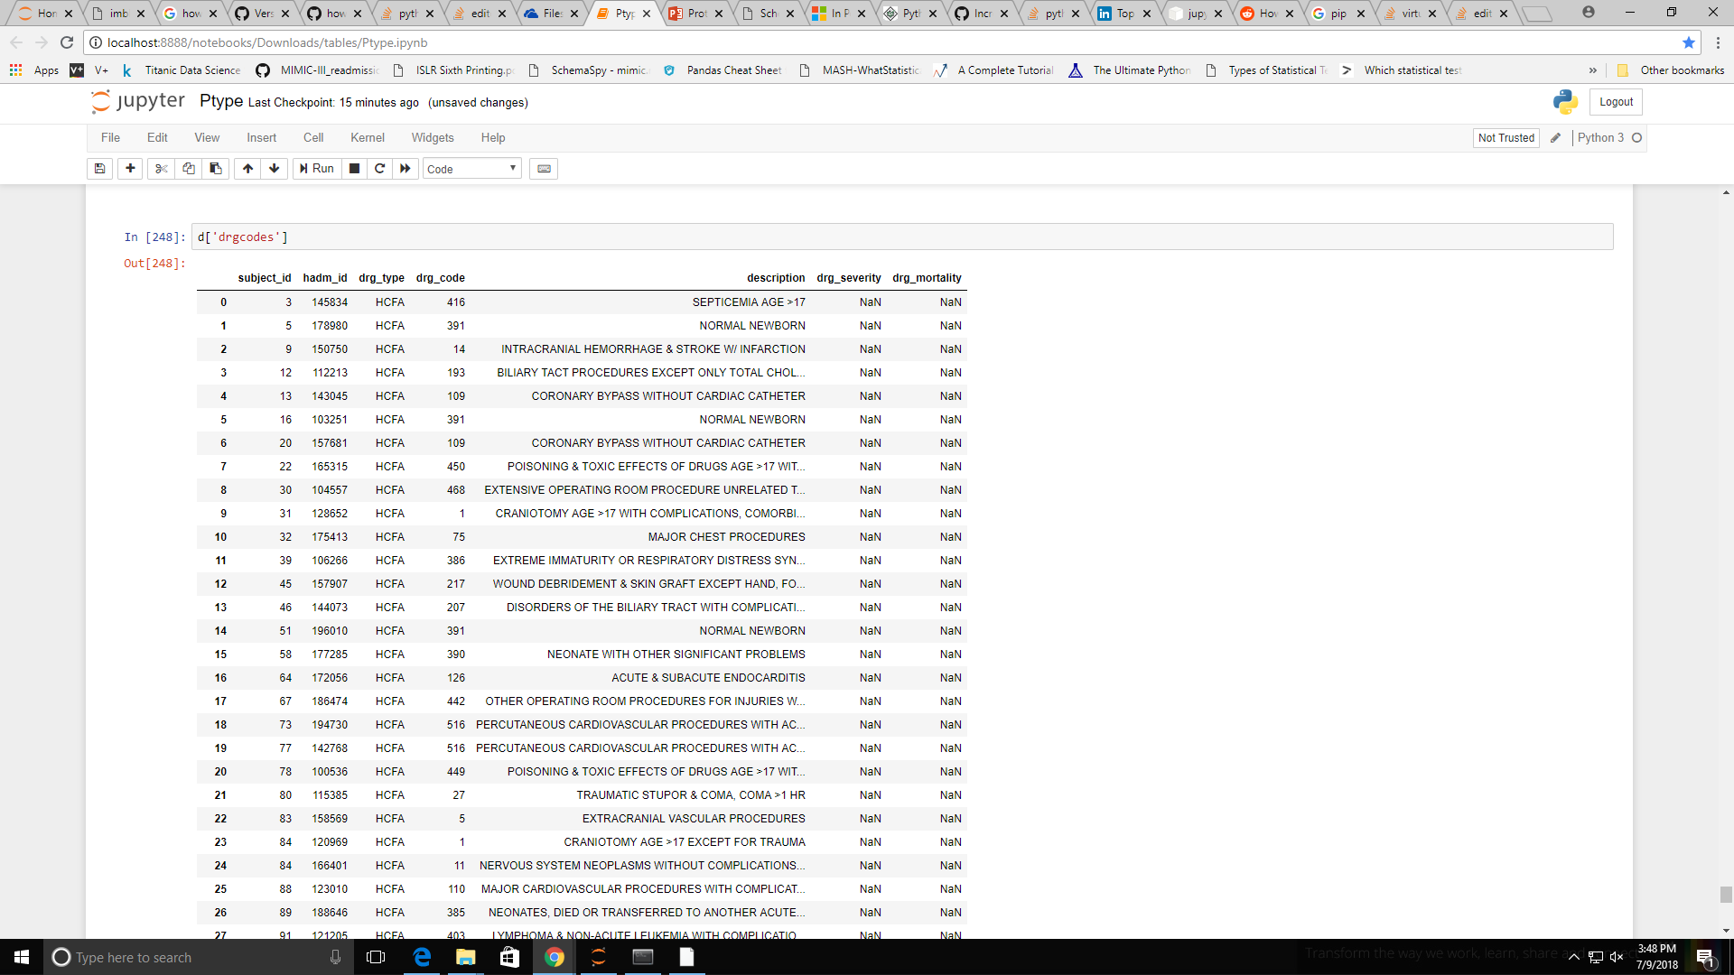
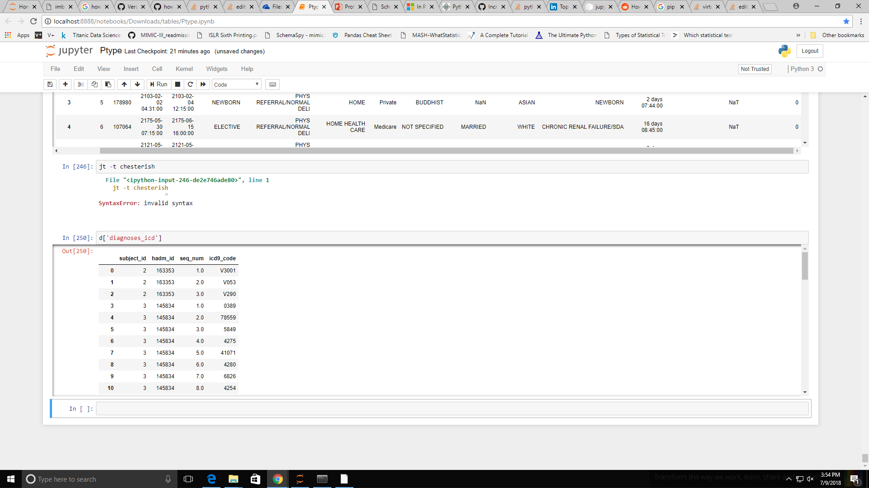
drgcodes
The drugcodes table gives us the drg_code and description. drg_type, drg_severity and drg_mortality are values that either are mostly null or contain the same value {HCFA}. Description is highly correlated with diagnoses itself as they convey similar information so this table might have questionable use.
diagnoses
The diagnoses table gives us the patient details along with the icd9_code of the disease which is a widely used disease and procedure classification system.

Slide 12
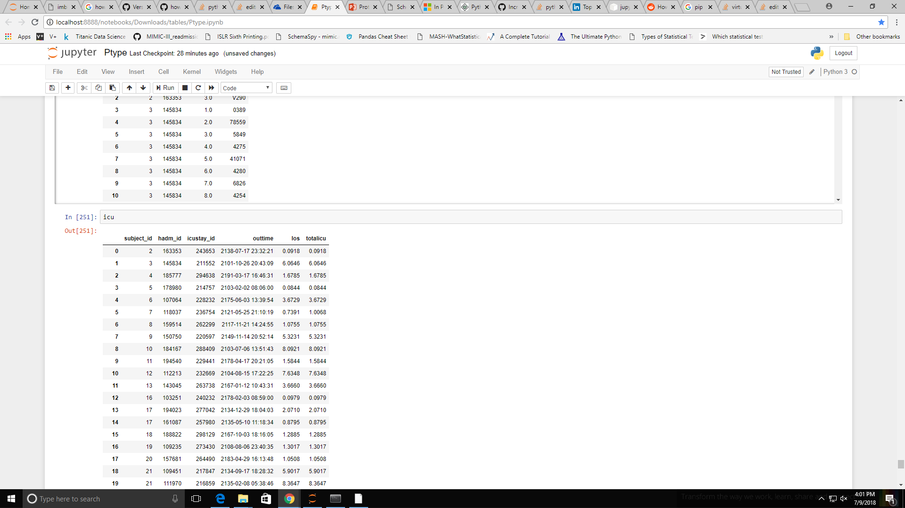
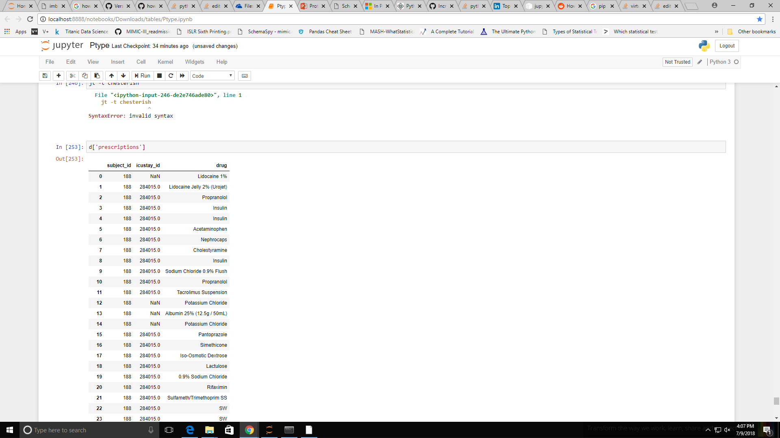
ICUstays
The icustays table provides us with the in and out times, from this we can calculate the los (length of stay) and totalicu (total time admitted to icu, only applies to patients with repeated ICU admits during the same stay)
Another variable we derive, is delta_t_icu_disch which is the time difference between discharge from ICU and discharge from hospital which might be a strong indicator. Hasty discharges may be correlated with erroneous decisions.
Prescriptions
The prescriptions table gives us the drug prescribed to each patient. The exact dosage, units, route of intake etc are given too but we drop these details as they would make the data parameters too specific to the point that we would not pick up on any trends. This maybe useful in drawing inferences on whether a certain drug causes readmission risks.

Slide 13
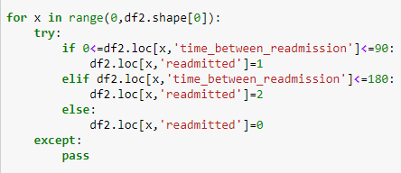
Target Variable
The target variable: readmitted, is generated as follows:
In essence, the readmitted column takes on 3 integral values, each representing a certain kind of readmission based on the time duration.
From 0 to 90 days, readmitted = 1
From 90 to 180 days, readmitted = 2
Otherwise, readmitted = 0

Slide 14
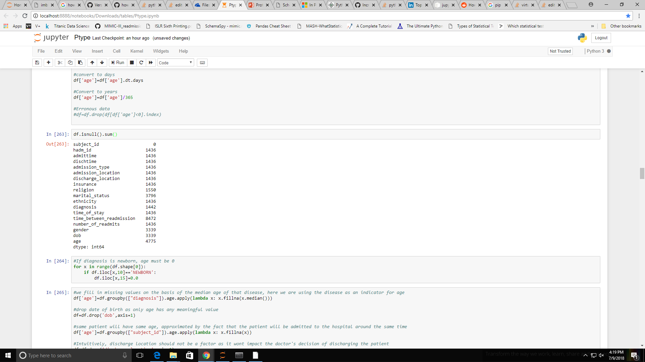
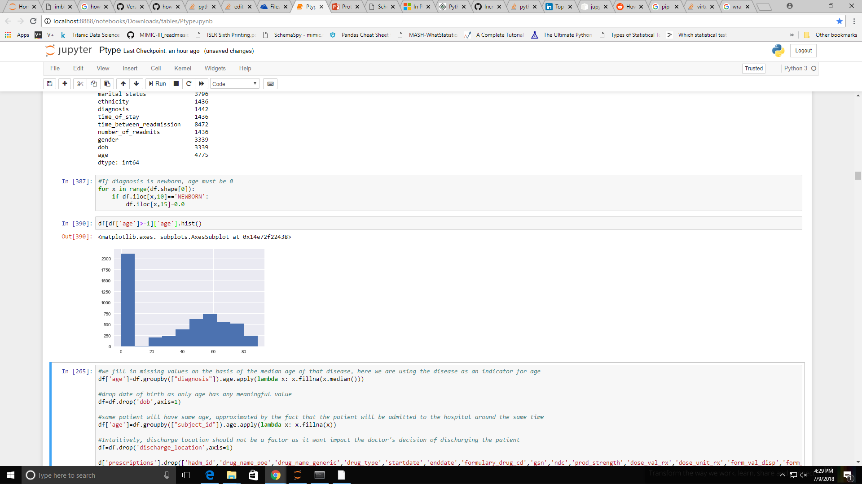
Data Cleanup
Here a rigorous analysis of missing data and theorizing on methods of imputation is done so as to preserve quantity of data without compromising on quality.
We observe that hadm_id is missing and a lot of the following columns have the same number of missing values. Upon further inspection it turns out that these 1436 rows have extremely sparse data with almost all columns missing. This could be due to poor data collection. Hence, we get rid of these.
We start filling in null values in the other features as follows:
Fill religion by most common religion
Fill missing age values as a normal distribution on age.
Gender is left untouched as it might not have much correlation.
Ethnicity is used to impute the religion data as it has high correlation.
Age histogram

Slide 15
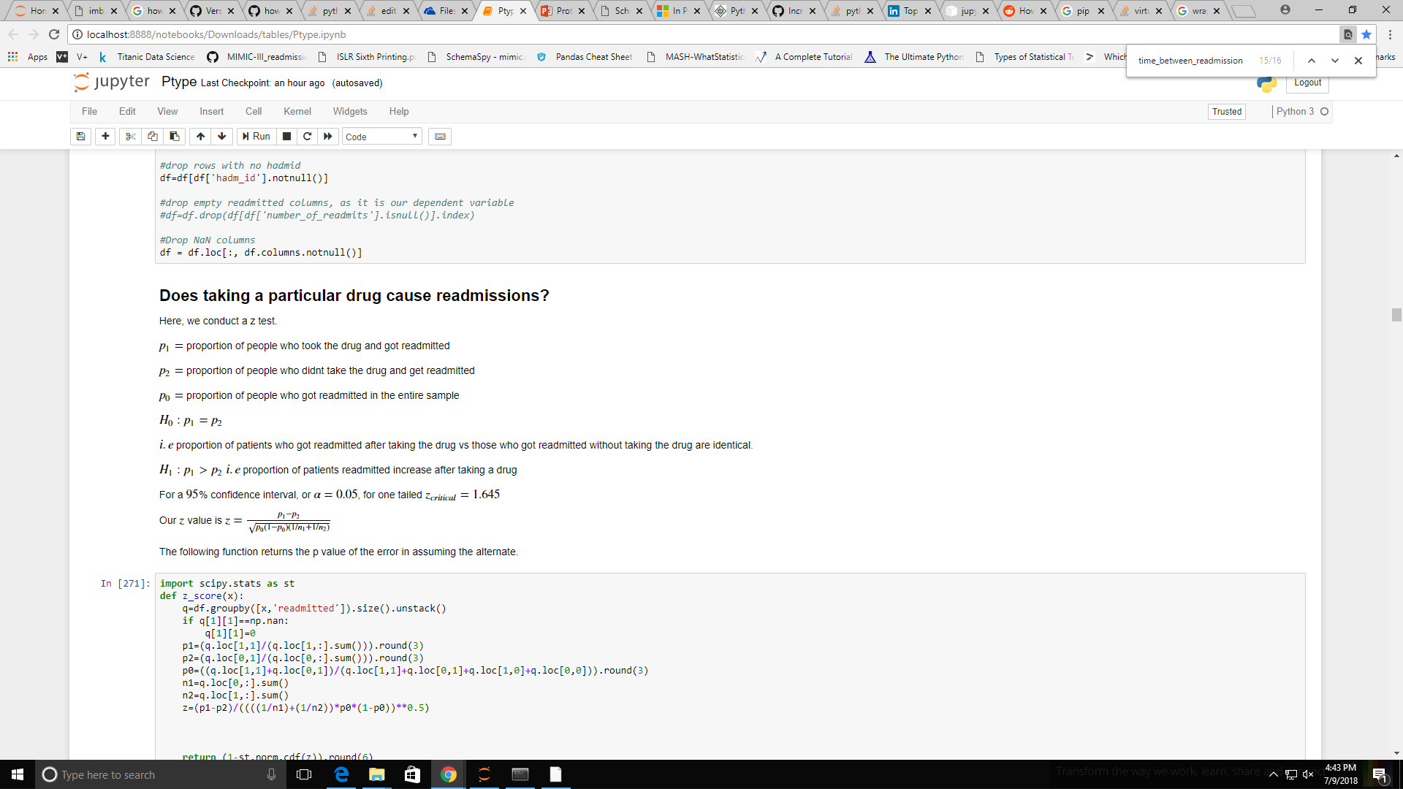
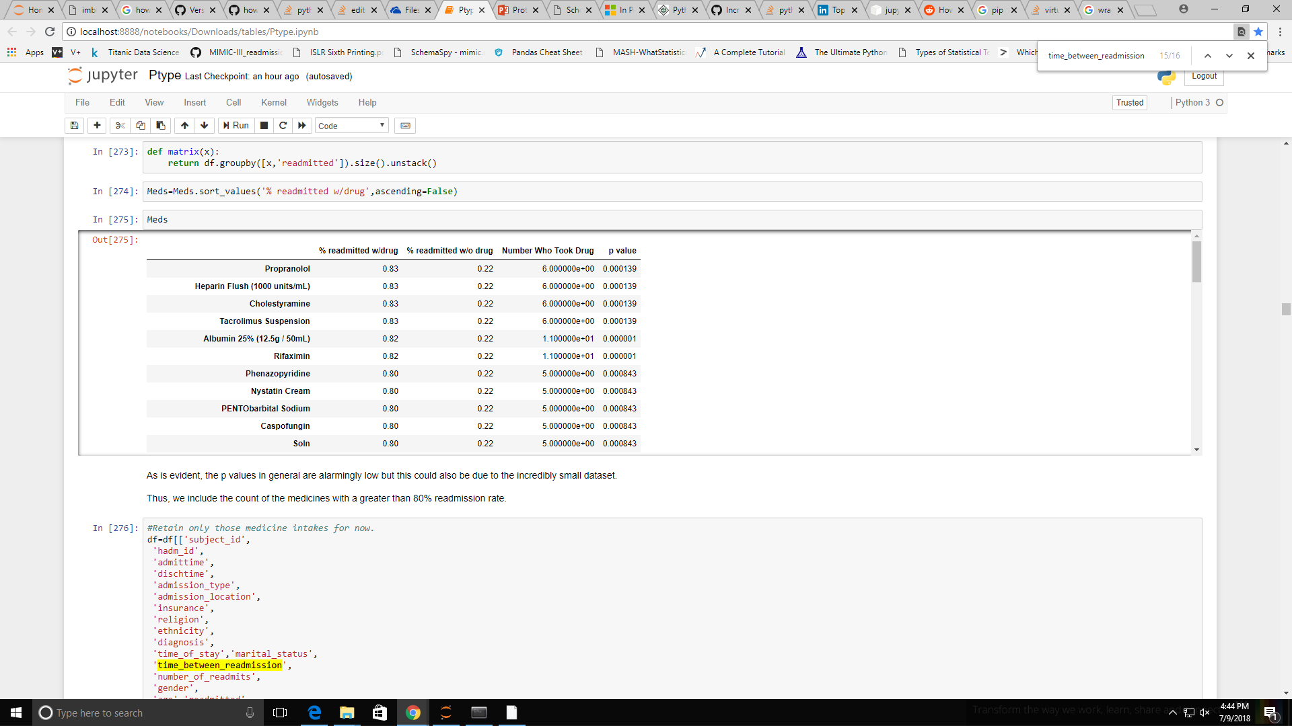
Prescriptions Analysis
We start feature creation and selection by examining which drugs are important for readmissions.
We use this standard binary proportioned z test to evaluate drug importance on readmissions. We select the 8 most influential drugs in our models based on p values.
As our data is sparse, we create a new feature, Number Of Drugs Taken, which is the number of 'significant' drugs taken from this list of 8

Slide 16
Data Categorization
A lot of categorical variables are too diverse for their own good and won't help us in making inferences.
Some of the simplifications we shall implement are:
Reducing all Catholic based religions and sects to 'CHRISTIAN'
Reducing all White and Black origin races to 'WHITE' and 'BLACK'
Classify all procedures, or 'bunch up', procedures of the same organ system. For eg, all eye based procedures are reduce to 'OP ON EYE'
Classify all diagnoses based on their ICD9_Code, I.e diagnoses are expressed in categories based on the organ system they affect. Eg, all dermatology related diagnoses become 'SKIN'.
Age, although continuous, is binned into groups of 10, I.e {(0,10),(10,20)…
We create a new feature 'CHRONIC' which is a binary valued variable that is an indicator function for chronic conditions. This is due to background research that indicates chronic conditions being at high risk for readmissions.

Slide 17
Bivariate Visualization
We start analyzing the categorical and continuous variables versus our target variable, readmitted.
Note; here we split readmitted into {0,1} for purposes of analysis because if a variable is significant to binary classification, further splitting it to {0,1,2} (which is basically diversifying the timeframe of readmission) should yield identical results.
The categorical/discrete variables we shall plot for are:
Admission Type
Admission Location
Insurance
Gender
Number Of Drugs Taken
Age
Marital Status

Slide 18
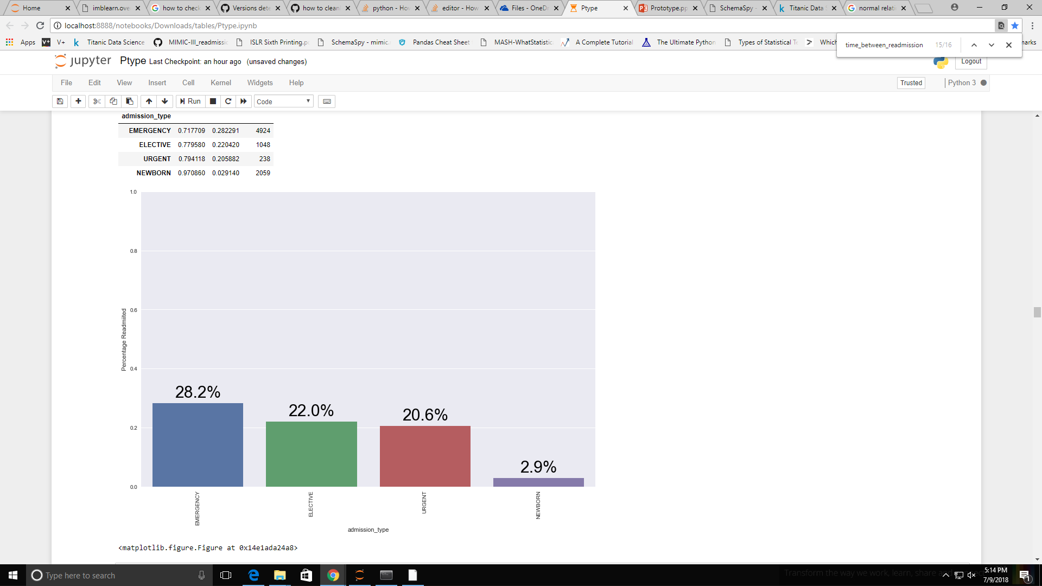
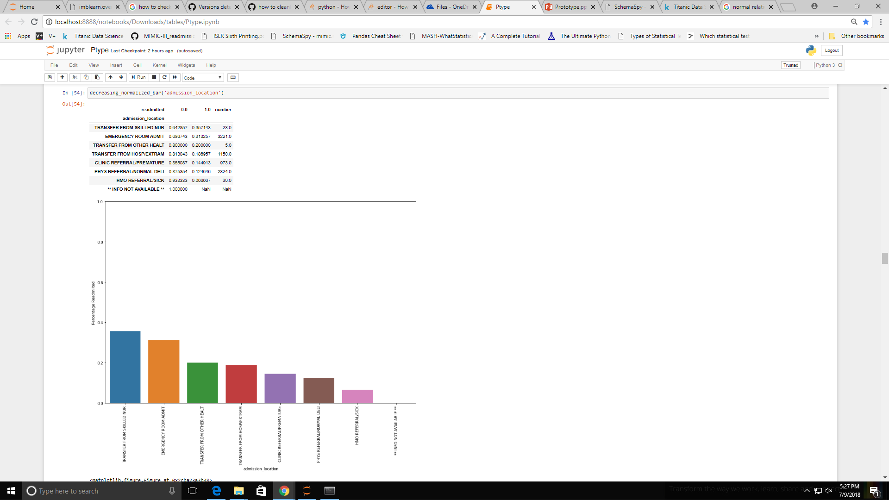
Admission Type
Emergency admits have a higher proportion of readmissions.
This could possibly be due to symptoms of an injury that start appearing much later.
For eg, neurological symptoms that show up much after an accident.
Admission Location
Emergency room admits again have higher correlations along with transfers from nurseries.
Clinical referrals and normal deliveries have lower readmissions as expected.

Slide 19
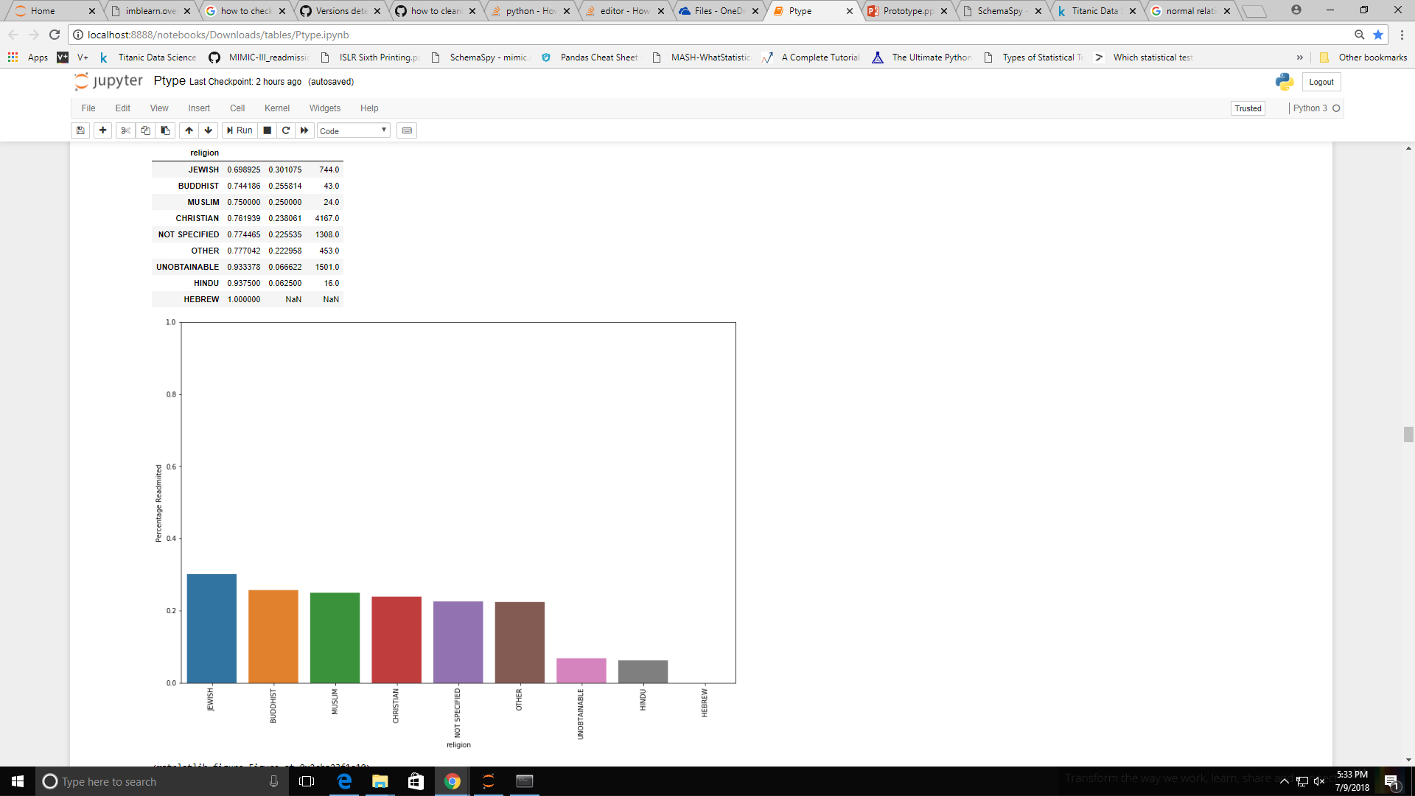
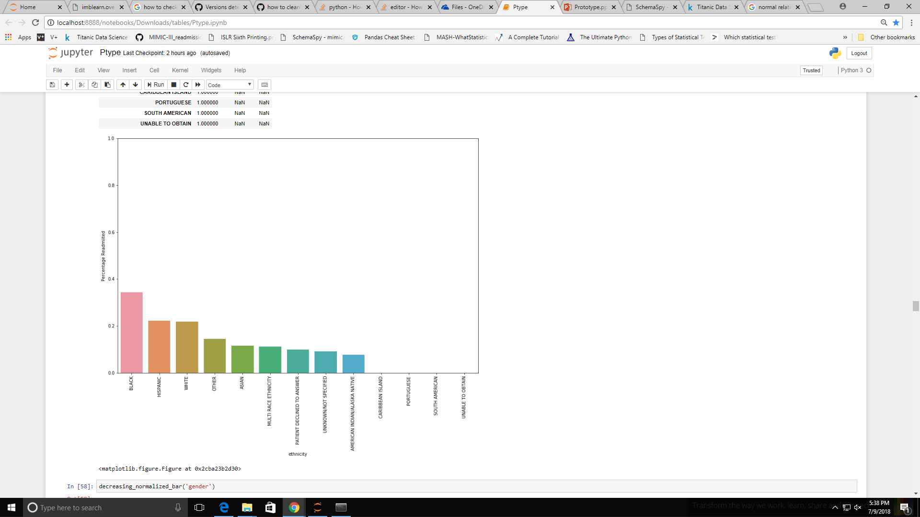
Religion
There is not much to infer here other than the surprisingly high number of readmissions amongst Jews and surprisingly low amongst Hindus. Religion could represent different lifestyles or beliefs which could affect whether someone takes certain medications or not and thus may have an effect.
Ethnicity
Blacks, Hispanics and Whites have notably higher readmissions than Asians and multi race ethnicities. Again, this maybe due to cultural lifestyles which is not necessarily captured explicitly.

Slide 20
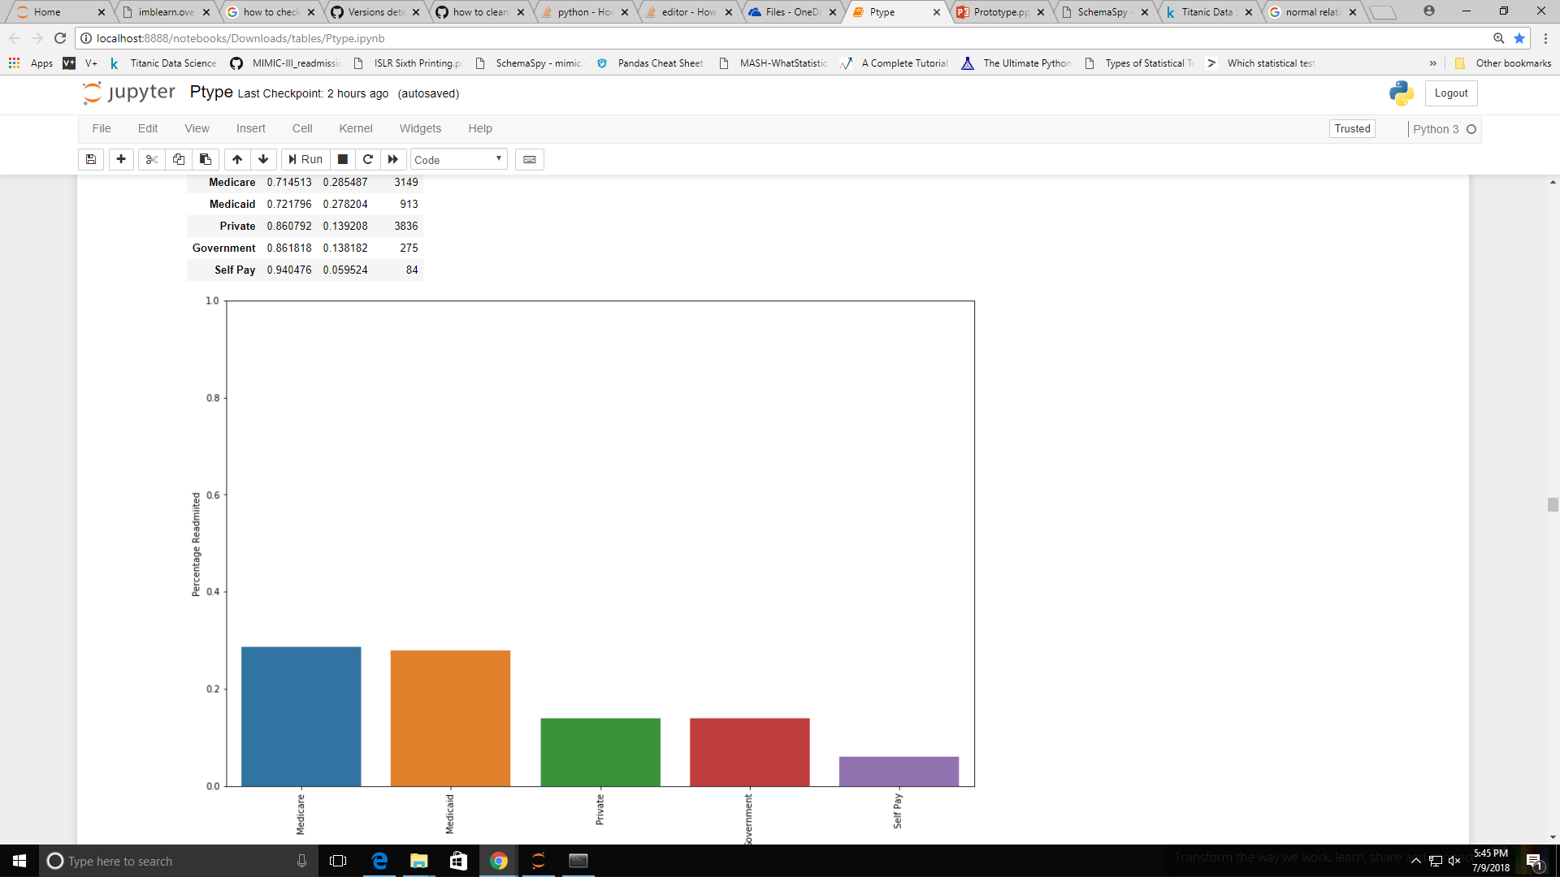
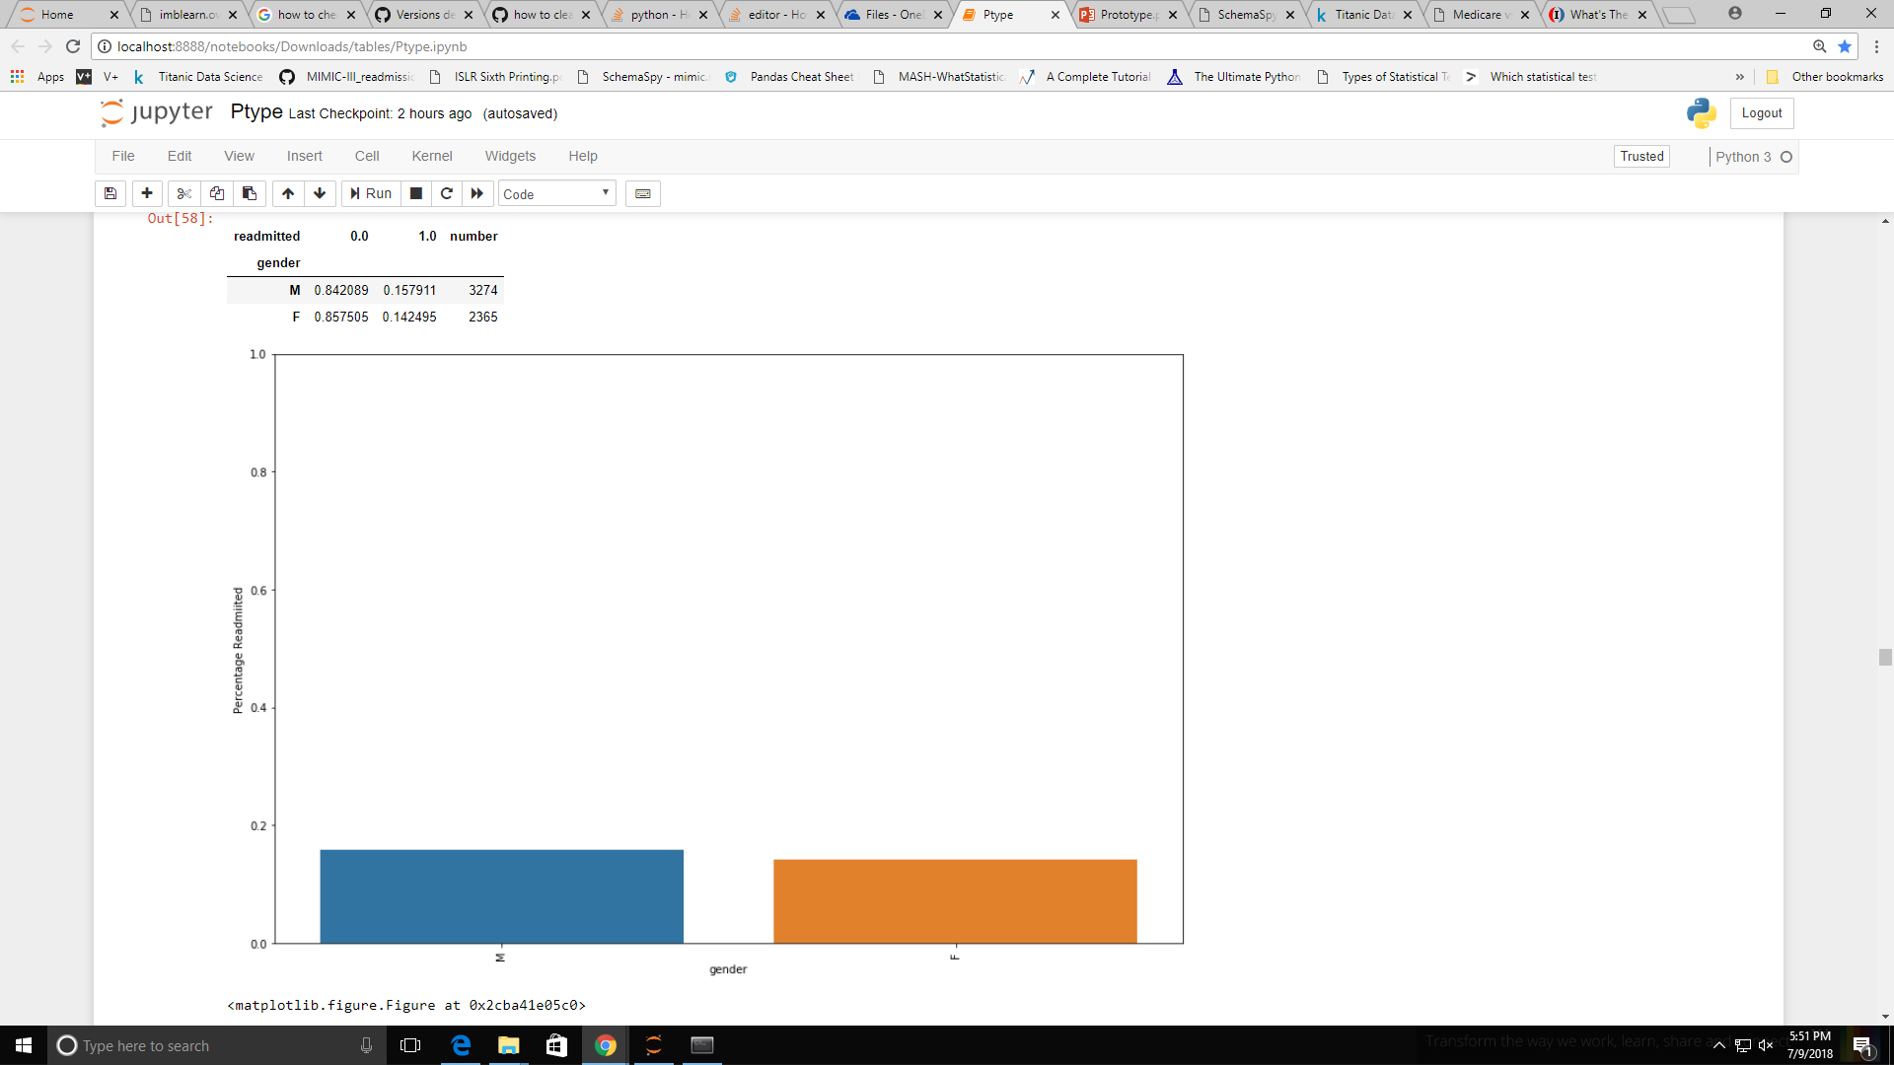
Insurance
Insurance shows much higher readmissions for Medicare and Medicaid which cater to elderly and poor respectively. This could reflect elders having inherently higher readmission risk and poor people having higher risks due to a worse off lifestyle.
Self pay is lowest which could be because patients would not be willing to pay the high hospital admission fees out of their pocket
Gender
Unsurprisingly gender does not play much of a role with a mere 2% difference in readmissions.
If the chi-square value of gender is too low it could potentially be dropped.

Slide 21
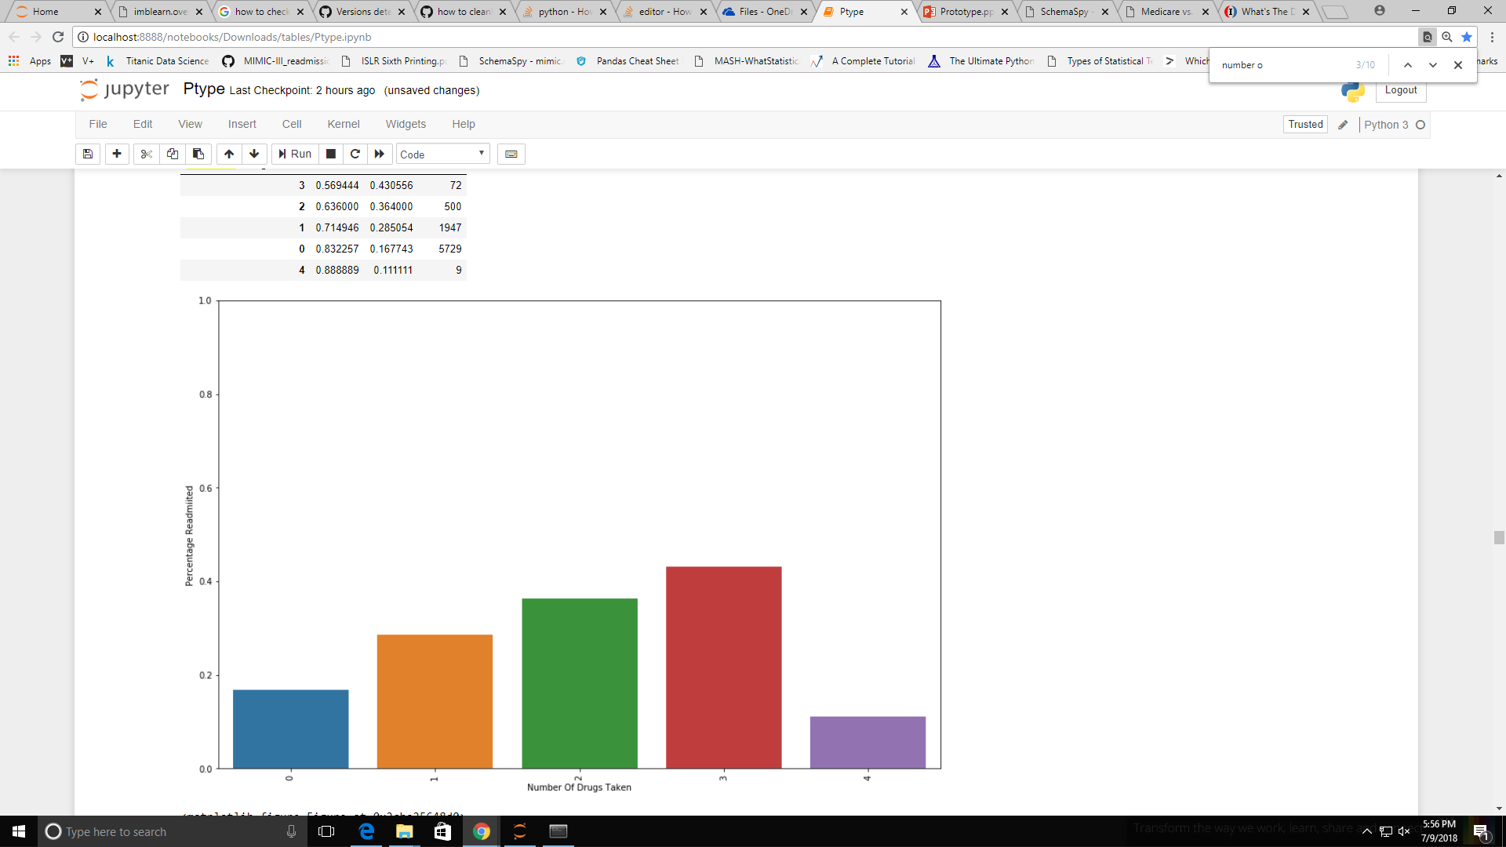
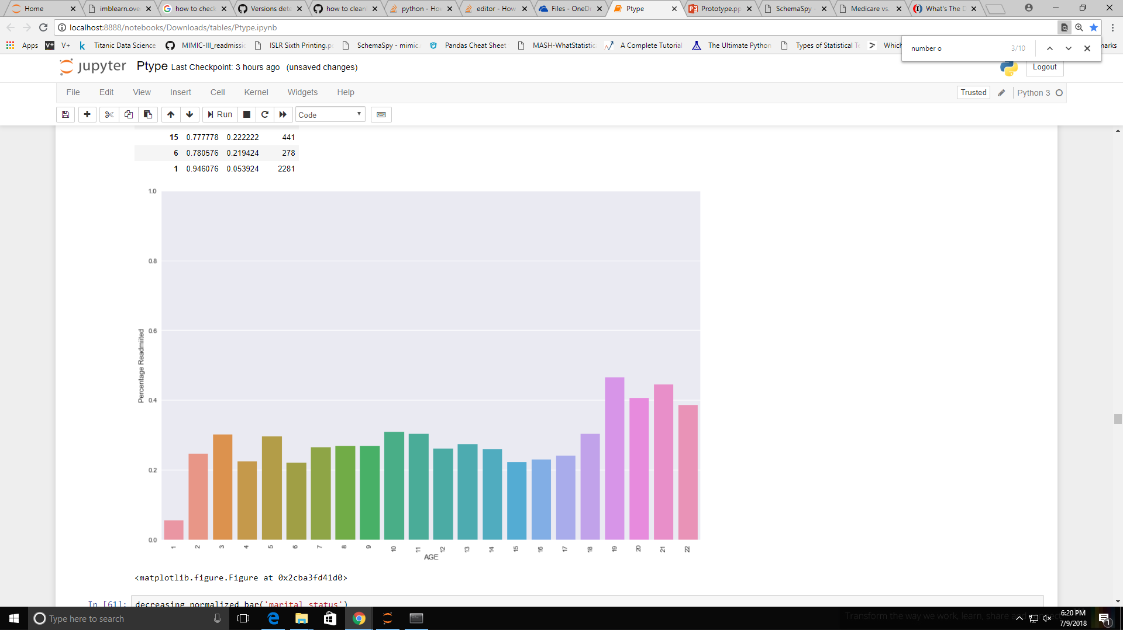
Number Of Drugs
As expected, the number of drugs almost linearly increases the chances of readmission. The reason 4 is unexpectedly low has more to do with the miniscule sample space that it occupies.
Age
Age has a rather interesting trend. It has very low readmission for newborns as most are healthy. After that it follows a rather weak bimodal distribution.
The first mode could possibly be explained by work related issues causing poor adherence of treatment.
The second mode is simply due to progressive age related diseases

Slide 22
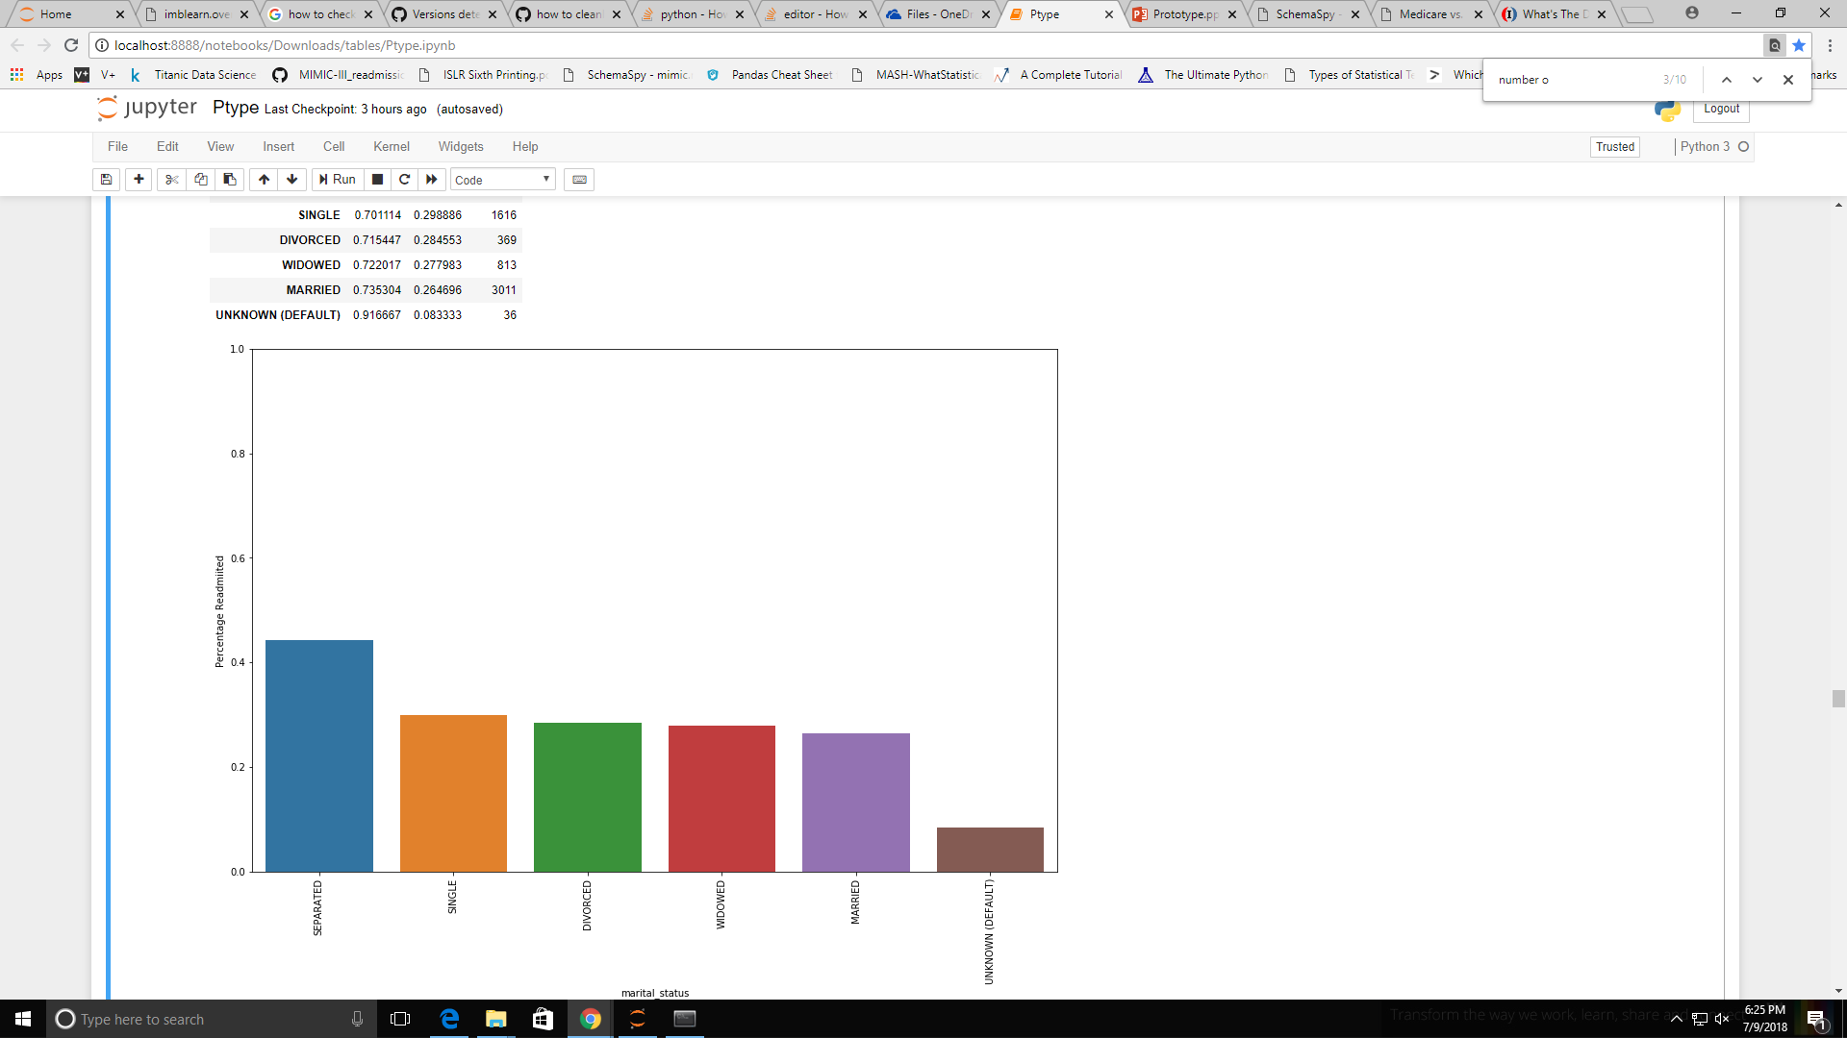
Marital Status
Marital status has a biased trend to those individuals who were separated.
This could be because most people who are 'separated', I.e. not legally divorced, due to the lack of a spouse could have a greater negligence to health.
Divorced, by the American law, generally entails people who have been legally separated.

Slide 23
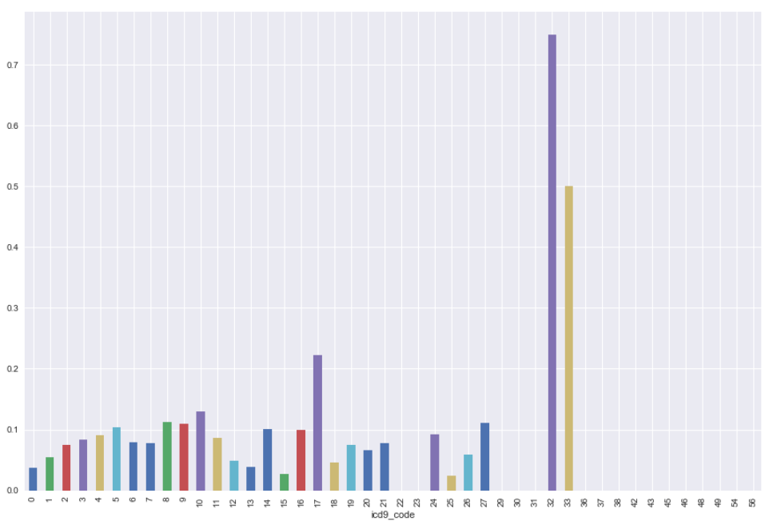
Charlson's Comorbidity Index
CCI is a commonly used 'points' system for deriving a factor based on the risk factor of a disease.
The exact points system starts from 1 to 6 (AIDS, Malignant Cancer)
Through the ICD9_Codes we assign a CCI value to each record and use it in our model.
As can be seen, it has a weak positive correlation.

Slide 24
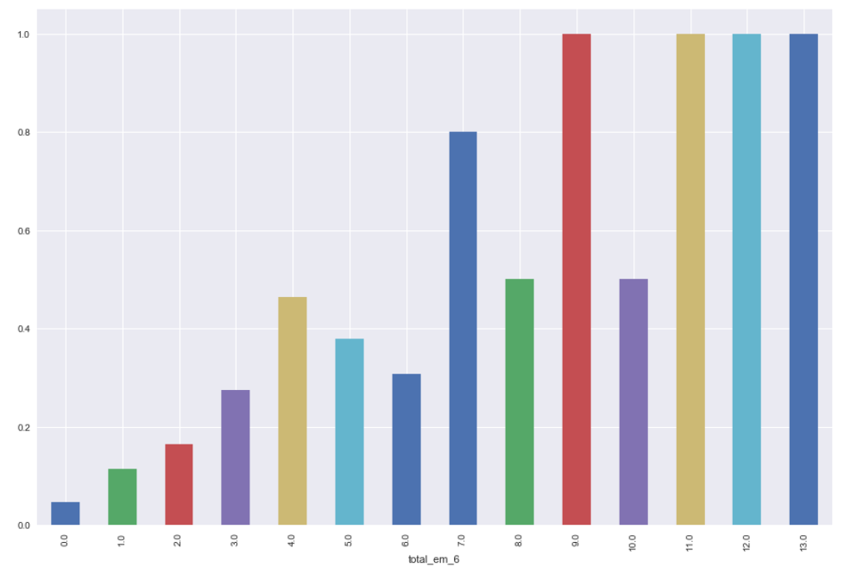
Total Emergencies Within 6 Months
Another commonly used metric is the number of emergency admits within 6 months.
We evaluate this by adding up all emergency admits from 6 months prior to the current admission in question.
As can be seen it has a very strong positive correlation.

Slide 25
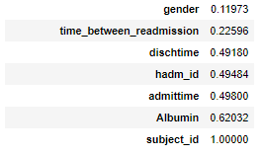
Final Cleanup and Feature Engineering
Prior to finalizing our datasets, a few operations are necessary:
Removing duplicate records
Dropping all patient identification parameters (eg subject ID) which don’t contribute to readmissions
Dropping nan columns that are erroneously generated.
Regarding features:
We can generate a chi-square correlation for each of the variables to check their impact. A lot of it is a reiteration of the visualizations in a mathematical sense.
Converting features to an acceptable input format for Python's ML algorithms.
The p values of some features (according to Chi Square) are given. Given a significance level of 0.10, they all can be rejected from
the Null hypothesis. Thus, they are statistically insignificant.

Slide 26
Building a Predictive Model
The models we apply (in order) are:
Logistic Regression
Support Vector Machines
Random Forest Classifiers
Neural Networks
Each of these are tuned using their hyperparameters to multiclass classification.
Most of these only take numerical values, so for the purpose of simplicity we one hot encode all the categorical variables.
One hot encoding simply makes every categorical value a feature unto itself which is represented in a binary format.

Slide 27
Imbalanced Data Handling
As is intuitively and statistically evident, the number of 'non-readmissions' is much higher; thus the model could simply predict everyone as 'not readmitted' and obtain a very high accuracy but with a very high false negative rate as well which is useless for our purposes.
To combat this we can do either of the two:
Penalized weights for the function (called class weights in python)
Over sampling of minority classes
In this use case, we use a synthetic data generating technique called SMOTE (Synthetic Minority Over Sampling Technique)

Slide 28
Data Splitting
No Readmissions
No Readmissions
No Readmissions
SMOTE
Readmissions
Readmissions
Train
Readmissions
Entire Data
Algorithm Testing
Machine Learning Algorithm
Test
Results

Slide 29
Evaluation Metrics
For evaluating algorithms we use
Accuracy
Confusion Matrix
Classification Reports
AUC
For us, the main area of concern is erroneously classifying actual readmissions as non-readmissions. I.e. the False Negative rates are more consequential than the False Positive rates.
Our priority is reducing the false negatives.

Slide 30
Summary
Model | Accuracy | Comments
Logistic Regression | 67%-69% AUC 0.66 | Reasonable false negative predictions.
Support Vector Machines | 74% | Good predictions for class 0. Random predictions for class 1.
Random Forests | 64% | Not reliable. AUC only 0.54
Neural Networks | 92% | Very poor learning for class 1.

Slide 31
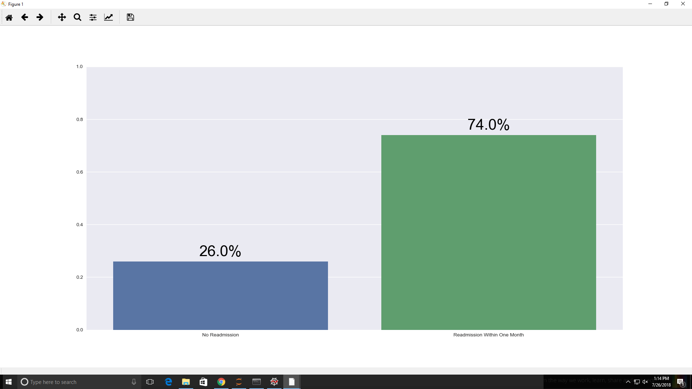
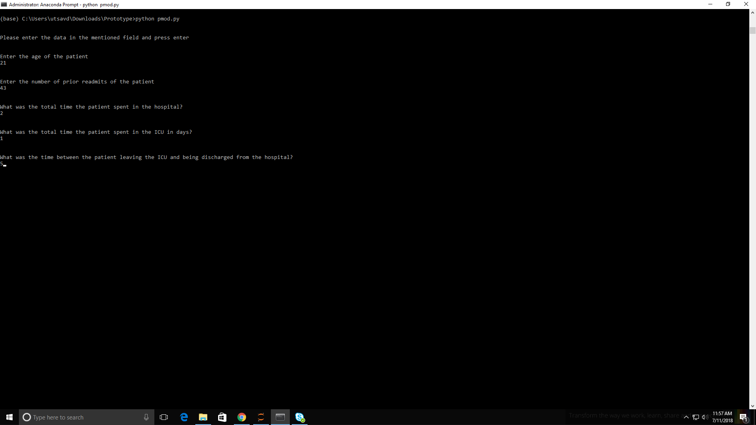
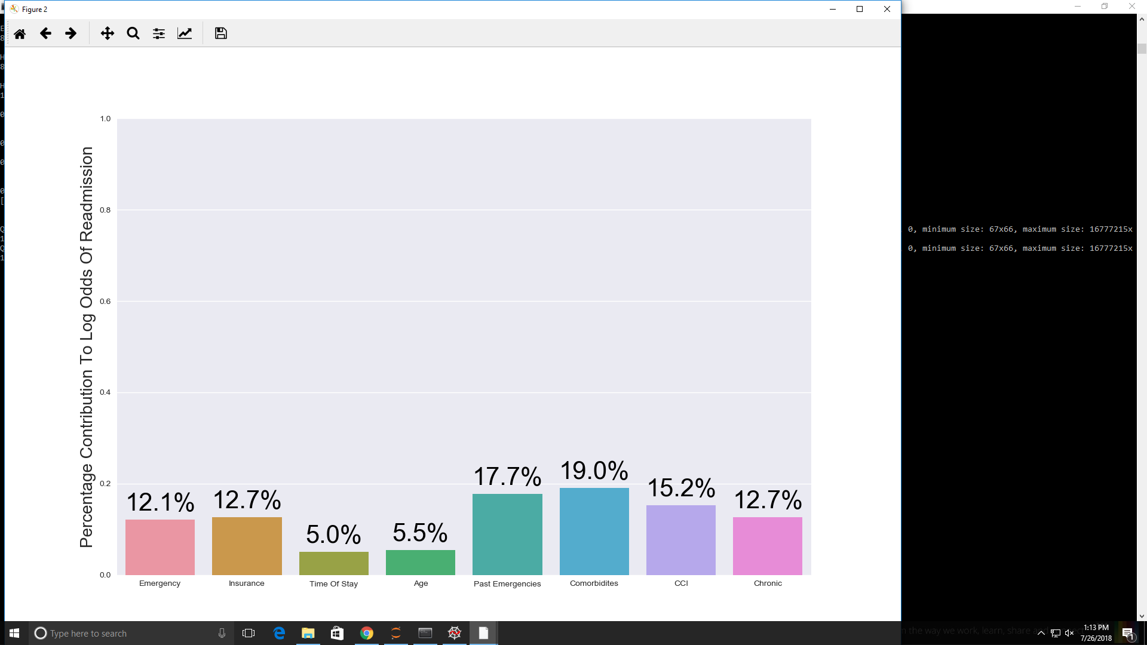
Sample Output
The command line output:

Slide 32
Challenges
The data accessed through the APIs was initially not sufficient and the model can be expected to improve through more training data as is the case for a variety of models.
A more diverse knowledge of machine learning models from my side would have aided in finding and tuning the parameters better.
Having someone with medical domain knowledge would have boosted the validity and confidence of the chosen predictors based on their inputs, and insights on otherwise hard to find relations could have been acquired.
More time to read research journals based on the fairly extensive work already done.
Exposure to other medical databases to find common trends.

Slide 33
The Way Forward
The major challenge now is the seamless integration of this model into patient records.
For this , one could use NLP to derive similar feature names from the foreign database.
ICD9 Code systems have been updated to ICD10 nowadays, hence a conversion system must be put in place
If patient data is segregated into multiple tables (like MIMIC III), then a localized program has to be written to combine them into a singular record.
A better UI should be made that is directly linked to the patient records where the doctor can simply see the model output aligned with the record itself.

Slide 34
References
MIMIC-III, a freely accessible critical care database. Johnson AEW, Pollard TJ, Shen L, Lehman L, Feng M, Ghassemi M, Moody B, Szolovits P, Celi LA, and Mark RG. Scientific Data (2016). DOI: 10.1038/sdata.2016.35. Available at: http://www.nature.com/articles/sdata201635
Pollard, T. J. & Johnson, A. E. W. The MIMIC-III Clinical Database http://dx.doi.org/10.13026/C2XW26 (2016).
Jamei, Mehdi, et al. “Predicting All-Cause Risk of 30-Day Hospital Readmission Using Artificial Neural Networks.” PLOS Medicine, Public Library of Science
Kansagara D, Englander H, Salanitro A, et al. Risk Prediction Models for Hospital Readmission: A Systematic Review. JAMA : the journal of the American Medical Association. 2011;306(15):1688-1698. doi:10.1001/jama.2011.1515.

